Slide 1


Chatbot for Tuberculosis Management Using GPT-4
Prepared by: Ying Ming Tang (S2180377)
Supervisor: Assoc. Prof. Dr. Vimala A/P Balakrishnan

Slide 2
Introduction to Tuberculosis
According to Global Tuberculosis Report,WHO(2022), Tuberculosis (TB) is an infectious disease that most often affects the lungs and is caused by a type of bacteria, Mycobacterium tuberculosis .
Tuberculosis infection: How did you get infection?
Source: CDC,2022
Tuberculosis infection: How does it spread?
Source: WHO,2022
01
02
Sneeze
Brain
01
Lungs
02
Cough
03
03
Spit
Spine

Slide 3
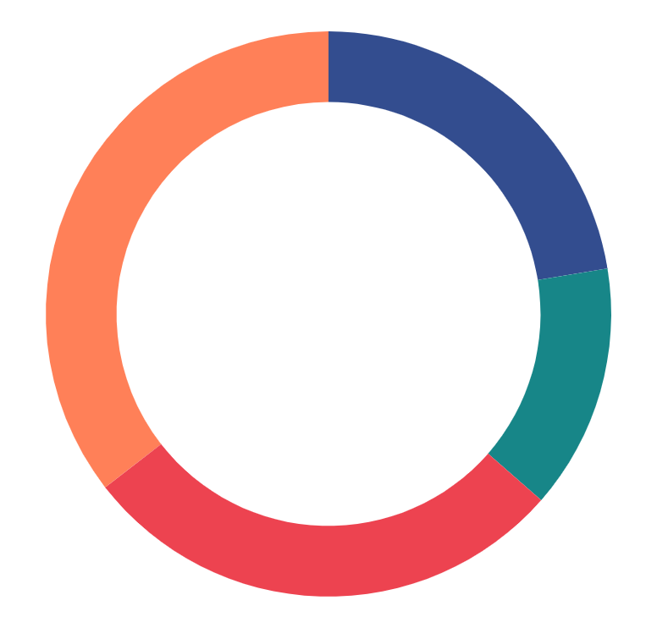
Introduction to Tuberculosis
10.6 Million
1.3 million
TB infection in 2022
Death from TB in 2022
In worldwide. TB is present in all countries and age groups (WHO,2022).
In worldwide. TB is the 2nd leading infectious killer after COVID-19 (WHO,2022)
+17%
Challenges for TB management in Malaysia
(CPG, Ministry of Health Malaysia, 2021)
cases in Malaysia for 2022
Delay in TB diagnosis and treatment
TB preventive treatment is not fully established nationwide
Socially disadvantaged population has difficulty in accessing TB services
For tuberculosis compare to 2021, from 21,727 cases in 2021 increased to 25,391 cases in 2022 (Ministry of Health Malaysia, 2023)
However, Tuberculosis is preventable and curable(WHO,2022). Thus public awareness about tuberculosis management is very important to everyone of us.

Slide 4
Introduction to GPT4, Large Language Model (LLM)
Large language models (LLMs) are foundation models that generate text, translate between languages, and write a variety of content using artificial intelligence (AI), deep learning, and massive data sets such as websites, articles, and books (IBM, 2023).
LLM have found widespread applications in various domains, including web applications, where they facilitate human interaction via chatbots with natural language interfaces (Pedro, R. et al.,2023).
Generative Pre-Trained Transformer (GPT) is a language model developed by OpenAI that is capable of producing response text that is nearly indistinguishable from natural human language (Dale, 2021).
OpenAI launched ChatGPT (GPT-3.5) and the newer GPT-4, both “large language models” (LLMs) that show far greater potential for healthcare and laboratory applications (Egli, A. ,2023)

Slide 5
Introduction to Chabot
The chatbots are computer programs that use natural language to interact with users(Athota, L. et al. ,2020).
Though not all chatbots are equipped with artificial intelligence (AI), modern chatbots increasingly use conversational AI techniques like natural language processing (NLP) to understand the user’s questions and automate responses to them (IBM, 2023).
Chatbot is a timely topic applied in various fields, including medicine and health care, for human-like knowledge transfer and communication (Xu, L. et al., 2021).

Slide 6
Problem Statement
Lack of Tuberculosis focused-chatbot
01
There’s various chatbot for healthcare such as Covid19 [Amer, E. et al. (2021)], Alzheimer's diseases [Mao, C. et al. (2023)], Chronic Diseases [Montagna, S. el al. (2023)] except Tuberculosis, and this leaves patients searching for information from unreliable sources.
02
Limited research building chatbot using LLM beyond BERT
The focus on Bidirectional Encoder Representations from Transformers (BERT) in healthcare chatbot research [Harilal, N., et al. (2020), Amer, E. et al. (2021), Deshpande, S., et al. (2021) ,Sung, Y. W. et al. (2023), Mao, C. et al. (2023), AKARSU, K., & Orhan, E. R. (2023)] leaves a gap for exploring other Large Language Models (LLMs), necessitating additional research in this area.
BERT is an open source and deeply bidirectional and unsupervised language representation, which is pretrained solely using a plain text corpus (IBM, 2023).

Slide 7
Lack of Personalised and Tuberculosis focused-chatbot
Authors | Title | Technique | Chabot’s Capabilities | Metrics
Mao, C. et al. (2023) | AD-BERT: Using pre-trained language model to predict the progression from mild cognitive impairment to Alzheimer's disease | Bidirectional Encoder Representations from Transformers (BERT) Long Short-Term Memory (LSTM) Bag-of-Word Model (BOW) Convolutional Neural Network (CNN) | Make prediction on MCI (Mild Cognitive Impairment) to AD (Alzheimer's disease) progression based on Q&A | Best Model: AD-BERT F1 Score: 68% AUC: 88 %
Amer, E. et al. (2021) | A Proposed Chatbot Framework for COVID-19 | Bidirectional Encoder Representations from Transformers (BERT) K-Nearest Neighbours Algorithm (KNN) Support Vector Machine (SVM) Naïve Bayes Decision Tree | Diagnosed symptoms for Covid-19 through Q&A. Provide recommendation and intervention for users | Best Model: BERT Accuracy: 96%
Sung, Y. W. et al. (2023) | A Study of BERT-Based Classification Performance of Text-Based Health Counseling Data | Bidirectional Encoder Representations from Transformers (BERT) Convolutional Neural Network (CNN) Recurrent Neural Network (RNN) Long Short-Term Memory (LSTM) Gated Recurrent Unit (GRU) | Offer and assign appropriate medical subjects according to the symptoms of the user. | Best Model: BERT Accuracy: 76% F1 Score: 75% Precision: 75% Recall: 76%
Rakib, A. B. et al. (2021) | Mental Healthcare Chatbot using Sequence-to-Sequence Learning and BiLSTM | Bi-directional Long Short Term Memory (BiLSTM) | As an virtual assistance to users as it provide empathetic responses whenever they feel the need for someone to listen | BLEU Score: 70%

Slide 8
Limited research building chatbot using LLM method beyond BERT
Authors | Title | Technique | Chabot’s Capabilities | Metrics
Y., Sri Lalitha, et al. (2023) | Conversational AI Chatbot for HealthCare | Recurrent Neural Network (RNN) K-Nearest Neighbours Algorithm (KNN) Random Forest Decision Tree | Offer prediction of the type of disease based on symptoms. | Best Model: RNN Accuracy: 0.96 Precision: 0.94 F1 Score: 0.90 Recall: 0.92
Harilal, N., et al. (2020) | CARO: An Empathetic Health Conversational Chatbot for People with Major Depression | Bidirectional Encoder Representations from Transformers (BERT) | Performing empathetic conversations and providing medical advice for people with major depression | Accuracy: Intent Classifier: 98% Emotion Classifier: 92% BLEU Score: 86%
AKARSU, K., & Orhan, E. R. (2023) | Artificial Intelligence Based Chatbot in E-Health System | Bidirectional Encoder Representations from Transformers (BERT) | Offers and provide personalized and timely healthcare information | Accuracy: 88% Precision: 89% F1 Score: 77% Recall: 86%
Deshpande, S., et al. (2021) | Self-Harm Detection for Mental Health Chatbots | Bidirectional Encoder Representations from Transformers (BERT) | Prediction on the response from users contain any intention for self-harm | Accuracy: 92%

Slide 9
Research Questions & Objectives
Research Objectives
RO1 | To perform exploratory data analysis (EDA) to reveal insights and patterns of unstructured tuberculosis data.
RO2 | To develop a chatbot for tuberculosis management using Large Language Model (LLM) GPT-4
RO3 | To evaluate the performance of the chatbot for tuberculosis management using different standard metrics.
Research Questions
RQ1 | What patterns and insights can be discovered in unstructured tuberculosis data?
RQ2 | How to use GPT-4 to develop a chatbot for tuberculosis management?
RQ3 | What metrics can we use to evaluate the performance of the chatbot for tuberculosis management?

Slide 10
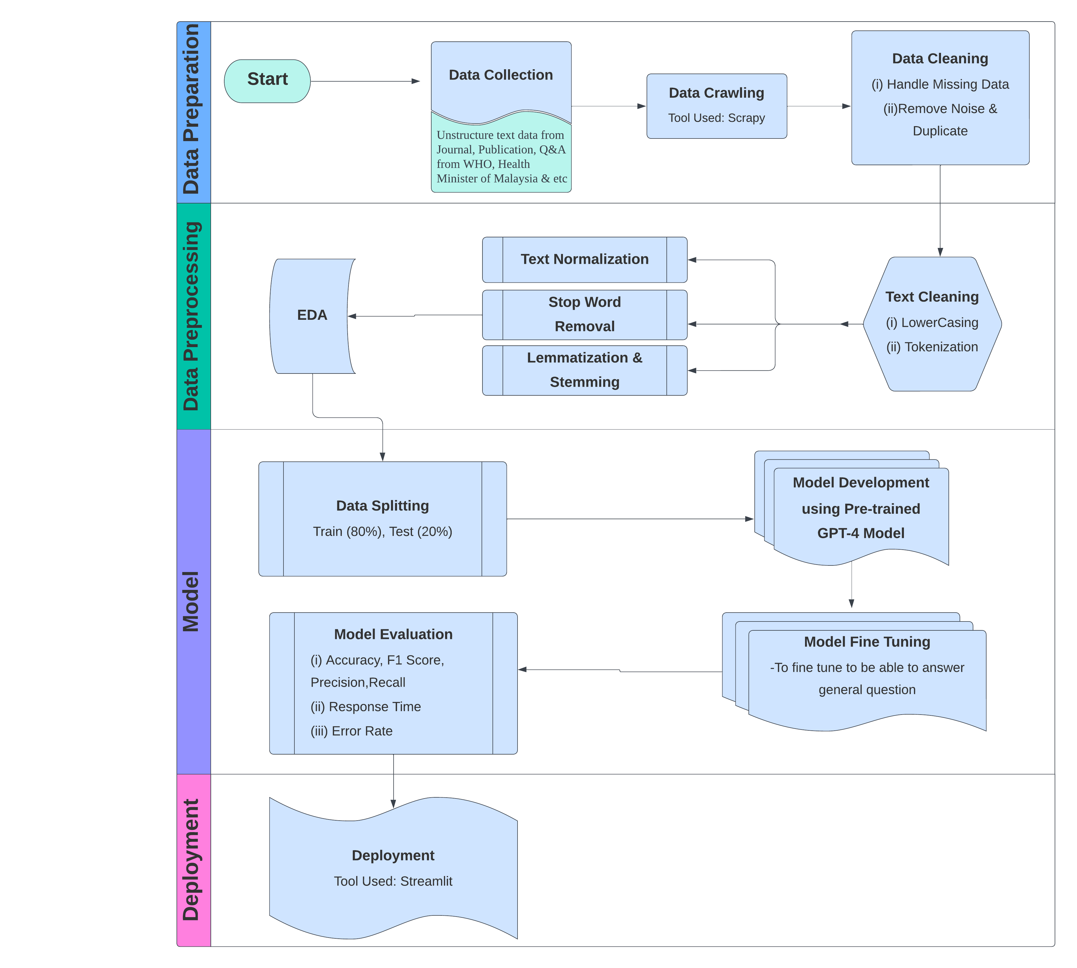

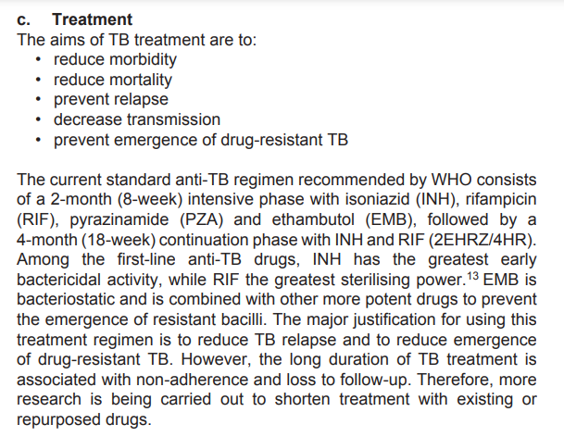

Methodology
Sample of Unstructure Data
Source: Clinical Practical Guideline 4th Edition, Management of Tuberculosis (Ministry of Health, Malaysia, (2021)) – SHOW Q& A SAMPLE)

Slide 11


Dataset
Source: Global Tuberculosis Report, WHO (2023)
Data Size:
Description: Provides key data and evidence about the status of the Tuberculosis epidemic and how to prevent it
Source: Global Tuberculosis Report, WHO (2023)
Data Size:
Description: Guides for clinical practice on management of Tuberculosis

Slide 12
Reference
AKARSU, K., & Orhan, E. R. (2023). Artificial Intelligence Based Chatbot in E-Health System. Artificial Intelligence Theory and Applications, 3(2), 113-122.
Athota, L., Shukla, V.K., Pandey, N., & Rana, A. (2020). Chatbot for Healthcare System Using Artificial Intelligence. 2020 8th International Conference on Reliability, Infocom Technologies and Optimization (Trends and Future Directions) (ICRITO), 619-622.
Amer, E., Hazem, A., Farouk, O., Louca, A., Mohamed, Y., & Ashraf, M. (2021, May). A proposed chatbot framework for COVID-19. In 2021 International Mobile, Intelligent, and Ubiquitous Computing Conference (MIUCC) (pp. 263-268). IEEE.
Bagcchi, S. (2023). WHO's global tuberculosis report 2022. The Lancet Microbe, 4(1), e20.
Bali, M., Mohanty, S., Chatterjee, S., Sarma, M., & Puravankara, R. (2019). Diabot: a predictive medical chatbot using ensemble learning. International Journal of Recent Technology and Engineering, 8(2), 6334-6340.

Slide 13
Reference
Chaix, B., Guillemassé, A., Nectoux, P., Delamon, G., & Brouard, B. (2020). Vik: A chatbot to support patients with chronic diseases. Health, 12(07), 804.
Dale, R. (2021). GPT-3 What’s it good for? Natural Language Engineering, 27(1), 113-118.
Egli, A. (2023). ChatGPT, GPT-4, and other large language models: The next revolution for clinical microbiology?. Clinical Infectious Diseases, 77(9), 1322-1328.
Ministry of Health, Malaysia, (2021). Clinical Practical Guideline 4th Edition, Management of Tuberculosis
Deshpande, S., & Warren, J. (2021, May). Self-Harm Detection for Mental Health Chatbots. In MIE (pp. 48-52).
Harilal, N., Shah, R., Sharma, S., & Bhutani, V. (2020). CARO: an empathetic health conversational chatbot for people with major depression. In Proceedings of the 7th ACM IKDD CoDS and 25th COMAD (pp. 349-350).

Slide 14
Reference
Mao et al. (2023): The paper discusses a chatbot system that predicts the risk of disease progression from Mild Cognitive Impairment (MCI) to Alzheimer's Disease (AD). It uses a deep learning framework based on the pre-trained BERT model and clinical notes from electronic health records (EHRs).
Mathew, R. B., Varghese, S., Joy, S. E., & Alex, S. S. (2019, April). Chatbot for disease prediction and treatment recommendation using machine learning. In 2019 3rd International Conference on Trends in Electronics and Informatics (ICOEI) (pp. 851-856). IEEE.
Mendapara, H., Digole, S., Thakur, M., & Dange, A. (2021). AI Based Healthcare Chatbot System by Using Natural Language Processing.Athota, L., Shukla, V.K., Pandey, N., & Rana, A. (2020). Chatbot for Healthcare System Using Artificial Intelligence. 2020 8th International Conference on Reliability, Infocom Technologies and Optimization (Trends and Future Directions) (ICRITO), 619-622.
Montagna, S., Ferretti, S., Klopfenstein, L.C., Florio, A., & Pengo, M.F. (2023). Data Decentralisation of LLM-Based Chatbot Systems in Chronic Disease Self-Management. Proceedings of the 2023 ACM Conference on Information Technology for Social Good.Bagcchi, S. (2023). WHO's global tuberculosis report 2022. The Lancet Microbe, 4(1), e20.

Slide 15
Reference
Pedro, R., Castro, D., Carreira, P., & Santos, N. (2023). From Prompt Injections to SQL Injection Attacks: How Protected is Your LLM-Integrated Web Application?. arXiv preprint arXiv:2308.01990.
Rakib, A. B., Rumky, E. A., Ashraf, A. J., Hillas, M. M., & Rahman, M. A. (2021, September). Mental healthcare chatbot using sequence-to-sequence learning and bilstm. In International Conference on Brain Informatics (pp. 378-387). Cham: Springer International Publishing.
Reddy, S. (2023). Evaluating large language models for use in healthcare: A framework for translational value assessment. Informatics in Medicine Unlocked, 101304.
Sung, Y. W., Park, D. S., & Kim, C. G. (2023). A Study of BERT-Based Classification Performance of Text-Based Health Counseling Data. CMES-Computer Modeling in Engineering & Sciences, 135(1).
Y., Sri Lalitha et al. (2023): This paper presents a conversational AI chatbot for healthcare designed to determine the patient's ailment type based on user input. It uses sequential models, including RNN, for data processing and symptom prediction. The chatbot suggests precautions and sends users to relevant specialists.

Slide 16
THANK YOU

